Slide 1



Tales from the Crypt: Lessons From Anesthesia Contract Negotiations
May 20, 2025
3:15 p.m.
Howard Greenfield, MD
Robert Stiefel, MD
Enhance Healthcare Consulting
www.enhancehc.com

Slide 2


Discussion Objectives
Understand current anesthesia coverage/negotiation challenges
Utilizing real world examples (with the names and places changed to protect the innocent!! ) to highlight key negotiation pressure points.
Help anesthesia group leaders adequately prepare for contract negotiation with hospital or ASC
Consider the hospital’s view of anesthesia subsidy negotiations
Identify take away lessons from each scenario
DISCLOSURE: Enhance Healthcare Consulting receives payments from Anesthesia Groups, Hospitals and Health Systems

Slide 3


TALES FROM THE ANESTHESIA CRYPT

Slide 4

Scene 1
The Delusional CEO

Slide 5



Scene 1 Setup
Mid-size Market
All-Physician group
Contract last negotiated 15 years ago
Flat $200K annual financial support
Group unable to recruit/retain physicians, increasing locums use
Full time providers working more
hours, making less – "circling the drain"
6-month Contract term notice given

Slide 6

Let the Horror Show Begin
Group financial model shows need for $8M subsidy
CEO wants group to add CRNA’s to all physician model
Medically directed model shows minimal financial impact
Facility refuses to adjust coverage requests despite poor OR/NORA
utilization
CEO proposes various financial solutions - which all equate to about
$1.5M of support – and says the group ask “will bankrupt the hospital”
After 3 months an FMV firm is engaged by hospital leadership

Slide 7


The Crypt Unfolds
Group financial losses mount, physicians working more hours and making less money
Facility threatens group with
RFP
Group revises the requested subsidy UP to $9M due to rapidly changing market
The Group votes to terminate negotiations, with about 2 months to contract end
Facility engages locums' firms for MOR, contracts with group at 2X the rate to cover CV

Slide 8

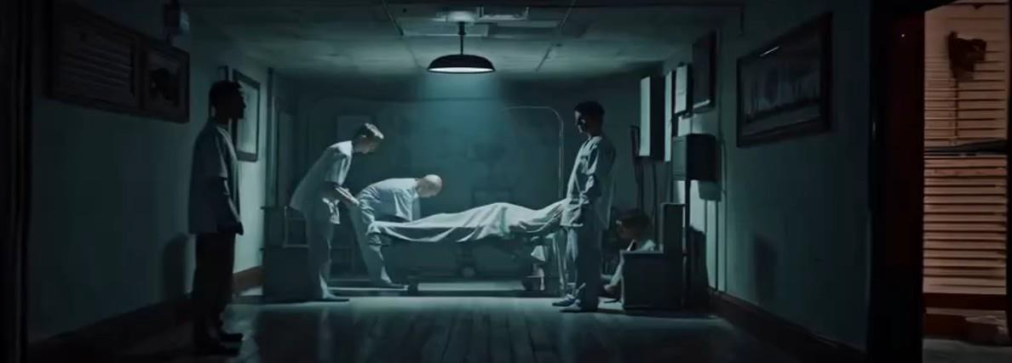

The Final Scene
Group expands coverage at their other facilities at favorable support levels
At the 2-month transition date, hospital has cobbled together approximately 75% of needed coverage through locums
Estimated cost $18-$22M annualized
No word on facility bankruptcy despite $10M+ additional spend than originally proposed – excluding loss of surgical revenue

Slide 9
Lessons Learned
Do not allow contracts to remain unchanged for a long period of time
Be proactive as financial realities impact:
  Realistic ability to recruit & retain providers in your local market
  Working hours & call frequency for full time providers
  Compensation and sign on or retention bonus
Educate hospital leadership about the current state of anesthesia in the local market
Model the cost of locums and transition expenses for the facility if you fall below full staffing
Having the contract “go off the rails” is in no one's best interest!

Slide 10

Scene 2
Big or Employed, Pick Your Poison

Slide 11

Scene 2 Setup
Large Metro Market – 2 hospitals
Local group acquired by BIGCO in
2017
Partners in group signed 5-year employment contracts
Post contract, partners given a “profit center”
  Contract renewal negotiated with hospitals; subsidy doubled
  BIGCO takes a fixed fee
  Unable to staff. BIGCO asks for another 50% stipend increase
Hospital issues RFP, dissatisfied with all responses
Hospitals decide to transition to employment

Slide 12
Let the Horror Begin
Due to attrition, when employment announced, group is short 6 anesthesiologists and 22 CRNA's (target FTE's 18 and 60)
90-day transition to employment, projected steady state loss of $12M to support anesthesia service, billing RFP issued by hospital
BIGCO attempts to enforce physician non-competes, loss of 4 additional physicians, also lose 8 more CRNA's. Hospital indemnifies remaining doctors against non-competes
Hospital closing anesthetizing locations, engages numerous locum firms
On transition to employment, approximately 8 physician and 20 CRNA locums are being used

Slide 13


The Crypt Unfolds
On transition date, hospitals are unable to staff 15% of desired anesthesia locations, delaying/losing elective cases
Full time providers are receiving significant "premium pay" to work extra shifts and call
Revenue cycle delayed for many providers due to credentialing
Hospitals and BIGCO are at odds, lawsuits back and forth
Hospital suing for loss of surgical volume/revenue
BIGCO suing to enforce non-compete, tortuous
interference
Hospital significantly increases provider pay and sign on bonuses

Slide 14
The Final Scene
Non-competes have been thrown out in summary judgement
6 months after transition, the hospital has recruited 7 anesthesiologists and 16 CRNA's, still using 2 physician and 12 locum CRNA's
Revenue cycle is stabilizing but 20% below projections
Able to staff all of target locations
Average anesthesia spend for the first 6 months was $2.8M/month, projected to fall
to $2M/month for the next 6 months
However, competing facilities in the market have raised compensation for providers and group providers are being tempted
Hospital leadership (many of whom have been replaced since this episode began) remain nervous about the stability of anesthesia services

Slide 15
Lessons Learned
Many large groups appear to struggle when initial provider contracts expire
While transitioning to a local group/employment is an option, this can impact:
  Provider retention/recruitment in the short term due to uncertainty
  Revenue cycle performance due to more favorable rates for the departing
entity
  Significant uncertainty due to non-compete issues
  Very large transition costs
If you are part of a large group, be proactive with the facility(s) in identifying
market challenges and the lack of "ideal" alternatives
Large groups should actively communicate their "value added"
quality/reporting/efficiency attributes to the hospital leadership
Having the contract “go off the rails” is in no one's best interest!

Slide 16



Scene 3- A Negotiation Horror Story
An

Slide 17


A Negotiation Horror Story
EHC engaged 10 /23 when anesthesia group threatened with RFP by hospital leadership.
Anesthesia contract last negotiated in 2006.
Cardiac surgery service started 2015 and group received $400,000 annually for Cardiac Anesthesia.
Group was asked to give up 50% of all Orthopedic OR’s when new surgery group brought in their own anesthesia providers with no call responsibilities
EHC was able to work collaboratively with group and hospital to create staffing grid and associated proforma
4/24 presentation made to hospital with subsidy request $6.9M for staffing grid of 9.5 CRNA and 29 anesthesiologists
7/24 group legal sent letter to hospital asking to begin negotiations for new contract
8/24 hospital planned to issue anesthesia RFP and requested
“Forensic Accounting” from group
10/24 RFP sent out to group and three other “anesthesia vendors”

Slide 18


A Negotiation Horror Story
RFP response due and hand delivered to hospital on 11/24
12/24- Hospital hired well known FMV firm “to review our RFP”??
1/25- Group delivered RFP response slide deck to hospital in formal presentation .
Subsidy for revised reduced staffing grid $6.2M
2/3/25 Hospital leadership needed “more time” to
review RFP responses
2/13/25- letter sent by group attorney requesting exclusive negotiation with no response from hospital
2/16/25- FMV firm still requesting financial data- but was not hired to do FMV??
3/25 Sunday afternoon meeting with group and hospital leadership to once again review staffing grid
4/25- Revised staffing grid and proforma at hospital request for 11 additional CRNAs with subsidy now at $7.5M
New contract ??????

Slide 19


Lessons Learned
Review or renew your PSA with hospital on a regular basis
Know your local market dynamics and compensation for both locum and permanent positions
Fellowship trained anesthesia sub –specialists command more dollars than generalists’ in all markets ( Pediatrics, Cardiac, Regional, ICU)
Provide hospital with accurate operational and financial data from the outset of contract discussions.
Begin discussions with detailed staffing grid to meet hospital expectations of coverage
Set time limit or create a burning platform for contract
negotiations.
Extended negotiation period or time is “not your friend”

Slide 20



Scene 4-Another Dumpster Fire

Slide 21

Another Dumpster Fire
Group working under contract signed 9/21. Requested $2.0M but signed for $980,000
1st amendment inked 8/22, but group continued to lose providers due to inferior compensation within the local market
Group hired EHC 11/22 to begin subsidy discussion with hospital
1/23 Group/EHC made presentation to hospital leadership. Initial staffing grid 18 CRNA and 37 Anesthesiologists to cover 39 sites per day.
Subsidy ask $14.0M due to Medicare increase 27% -35% in the last ten years and Blue Shield decrease 28% to 22 % over same period.
Total ASA units up 11% and revenue down 9% during the decade
5/22-5/23 Group lost 14 anesthesiologists and 3 CRNAs to other local market positions
No response from hospital leadership or CMO until 2/22/23 when CEO/CMO had a “ town hall” to discuss anesthesia issues with group and propose hospital employment
Group issued 120-day termination letter on 2/24/23 effective 6/25/23
Hospital cancelled F/U meeting with group and decided to hire their own consultant

Slide 22


“Firefighting”
3/23 Letter to hospital leadership requesting immediate 5M retention bonus bonus
3/23- Response by hospital leadership refusing retention bonus and reinforcing desire to employ group
4/18/23 – Hospital consultant proposed 10.2M annual subsidy PLUS retention bonus and 100% locum coverage for 6 months
4/20/23- Hospital administration sent letter to medical staff stating they had reached an agreement with the exclusive provider
4/28/23- Group and hospital leadership met to clear up inconsistencies in term sheet
5/26/23- Anesthesia group turned down hospital offer and transitioned to staffing agreement for remainder of term 6/25/23 and thereafter if hospital would prefer
5/31/23- Letter from hospital council accusing group of “bad faith” negotiations and immediate waiver of non- solicitation/ non –competes.
6/21/23- Staffing agreement signed by both parties with specific rates for shifts, call, OB, Cardiac, Pediatrics, Trauma coverage.

Slide 23

Lessons Learned
Have a thorough understanding of your
payor contracts and LTM revenue stream
Consider RCM audit by independent third party prior to stipend negotiation
Be prepared to discuss your groups staffing
model including subspecialty coverage and vacation
Explore alternative staffing options- you will
be asked about adding more CRNA/AA
“Call is not Free nor is it unproductive time”
Review your present contract with legal council and understand notice and termination provisions
Evaluate your local market ( within a 1-hour
drive) for compensation and benefits -for full time and locum
Negotiations don’t happen overnight- they
may take awhile with many unexpected
twists and turns.
Emotional for group leadership and all members.

Slide 24

Thank You!
QUESTIONS?

