Slide 1


Fun with Numbers: Insights from Real World Data
May 19, 2025
3:15 p.m.
Howard Greenfield, MD
Robert Stiefel, MD
Enhance Healthcare Consulting
www.enhancehc.com

Slide 2
Objectives
Understand data points used in anesthesia contract negotiations
Review benchmarking approaches which add validity to data analysis
Identify ways to utilize your own groups' data
Display data to clearly convey market realities and support financial models
DISCLOSURE: Enhance Healthcare Consulting receives payments from Anesthesia Groups, Hospitals and Health Systems
2

Slide 3



Numbers, Numbers Everywhere!

Slide 4
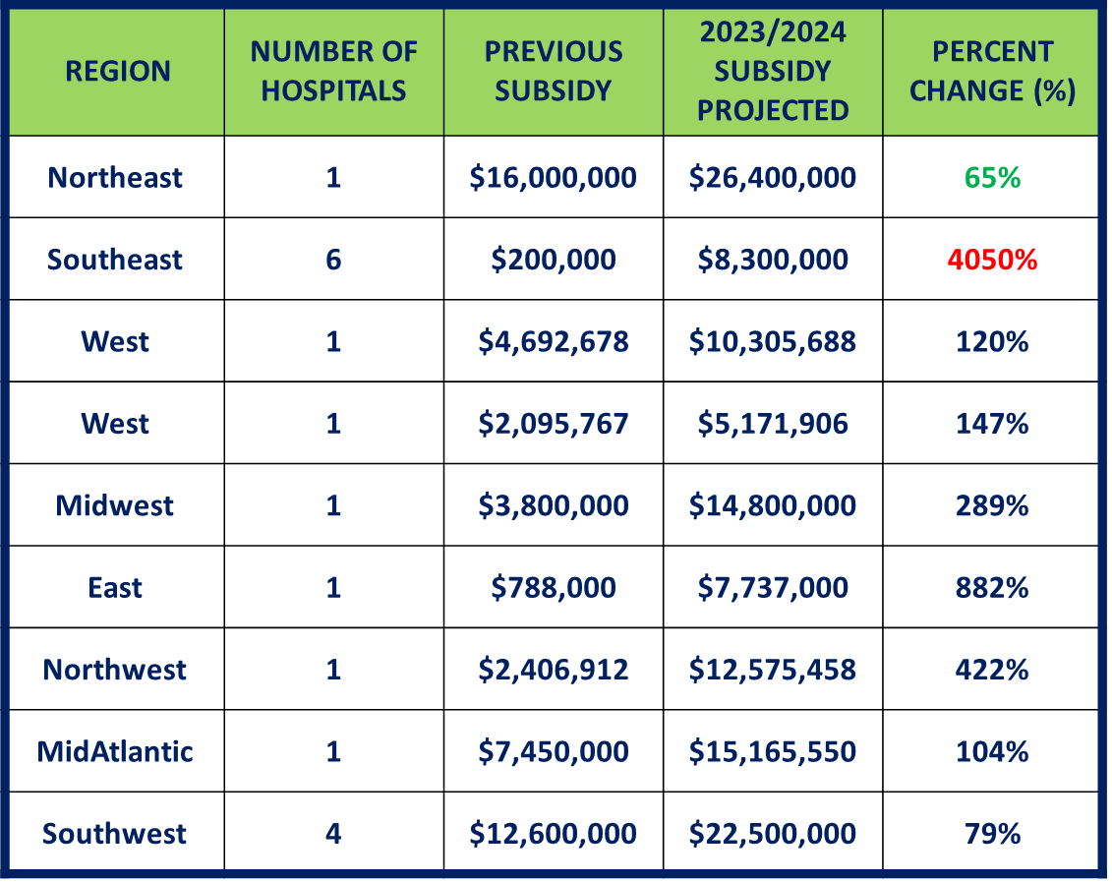

Some Numbers are REALLY BIG

Slide 5
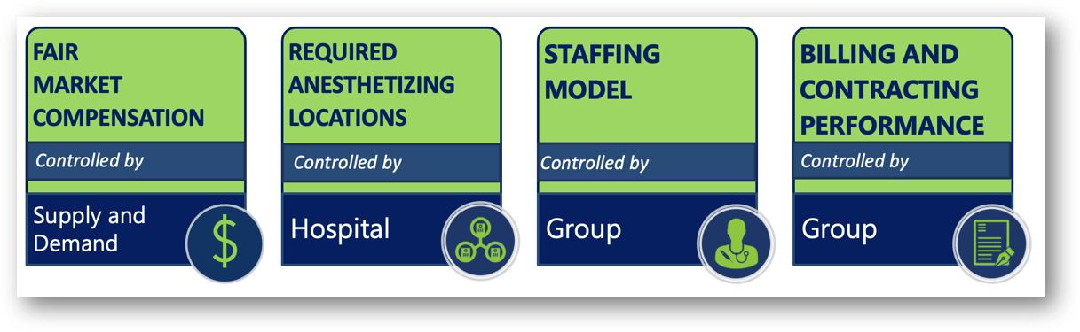
Anesthesia Financial Drivers
5

Slide 6



Fair Market Compensation
Surveys are often based on older data
Not an issue in a stable market, but can be misleading in the volatile anesthesia market of 2025
MGMA lags 12-15 months
There are many FMV companies and surveys, often show wide disparity
GasWork.com offers real time snapshot but heterogeneous mix of ads ( W-2,1099, pain management, ASC only)
Local market job offers are key indicators
Not all groups have identical workload, adjustment based on:
Call frequency and value of call
Annual hours worked
Case/patient complexity
Subspecialty requirements- Cardiac, Peds, Trauma
6

Slide 7

Surveys can be deceiving!!
Alabama | $323,940
District of Columbia | $295,970
Florida | $404,100
Georgia | $244,430
Illinois | $301,580
Indiana | $378,850
Iowa | $385,010
Kansas | $315,890
Kentucky | $280,130
Maine | $415,540
Maryland | $349,580
Michigan | $337,220
Minnesota | $465,340
Montana | $459,360
Nebraska | $389,480
New Hampshire | $402,950
New Mexico | $318,450
New Yor k | $262,530
North Caroli na | $397,850
Ohio | $386,200
South Carolina | $306,440
Tennessee | $364,200
Texas | $254,010
Virgi nia | $326,130
West Virginia | $193,830
Uninformed analysis may use
government data as a real view of
FMV. This may be the first perspective of hospital leaders or FMV firms
Here’s annual mean anesthesiologist pay for the 24 states and Washington, D.C., which were released using the BLS metrics.
7

Slide 8
2024 MGMA Midwest Compensation
Provider Compensation
2024 REPORT BASED ON 2023 DATA
Total Compensation by Geographic Section
Midwest Region
Specialty | Group Count | Count | Mean | 25th %tile | Median | 75th %tile | 90th %tile
Anesthesiology | 37 | 1,394 | $526,311 | $449,513 | $527,785 | $596,798 | $711,395
Certified Registered Nurse Anesthetist | 29 | 798 | $246,211 | $214,862 | $244,064 | $271,086 | $310,001
2023 REPORT BASED ON 2022 DATA
Specialty | Group Count | Count | Mean | 25th %tile | Median | 75th %tile | 90th %tile
Anesthesiology | 62 | 891 | $517,244 | $402,383 | $527,714 | $631,769 | $744,966
Certified Registered Nurse Anesthetist | 18 | 657 | $223,472 | $191,497 | $221,744 | $249,184 | $290,566
2022 REPORT BASED ON 2021 DATA
Specialty | Group Count | Count | Mean | 25th %tile | Median | 75th %tile | 90th %tile
Anesthesiology | 32 | 968 | $462,468 | $352,500 | $452,834 | $584,729 | $701,816
Certified Registered Nurse Anesthetist | 22 | 685 | $205,532 | $175,473 | $200,436 | $230,630 | $254,997
2021 REPORT BASED ON 2020 DATA
Specialty | Group Count | Count | Mean | 25th %tile | Median | 75th %tile | 90th %tile
Anesthesiology | 44 | 789 | $504,196 | $426,638 | $491,525 | $575,230 | $692,227
Certified Registered Nurse Anesthetist | 29 | 887 | $194,401 | $169,384 | $195,632 | $213,932 | $233,948
8

Slide 9
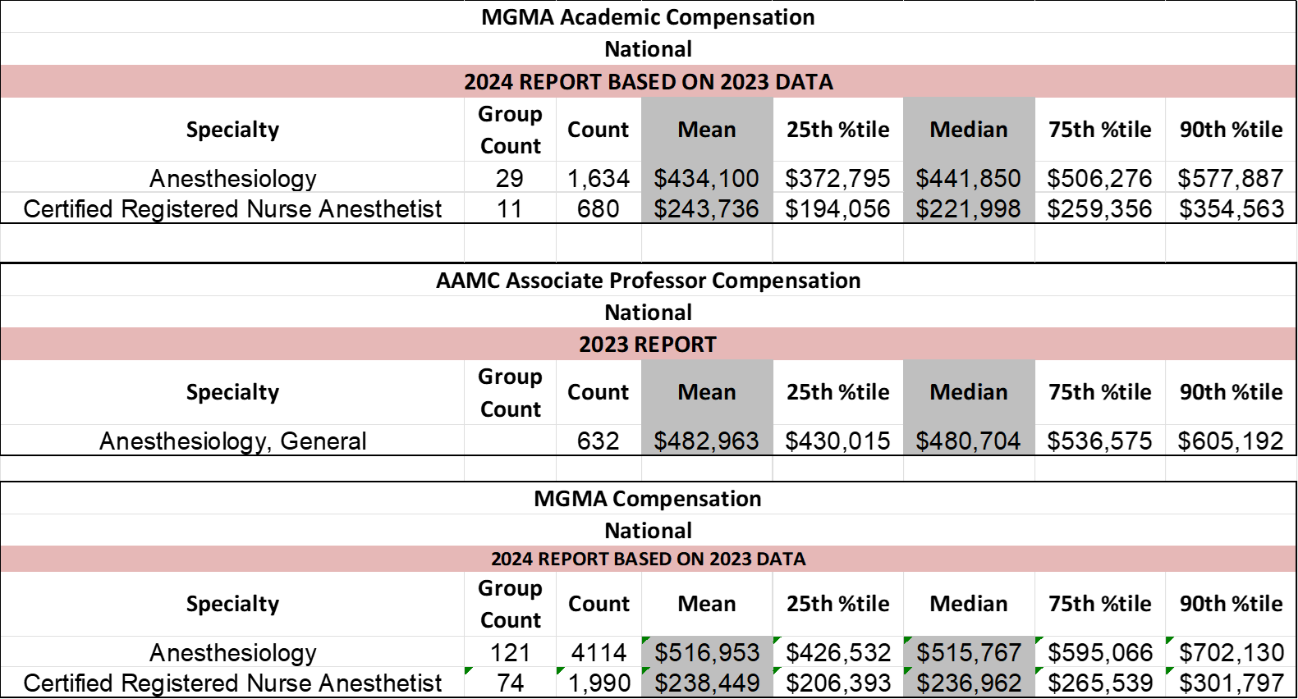

Academic Medical Center Surveys
9

Slide 10
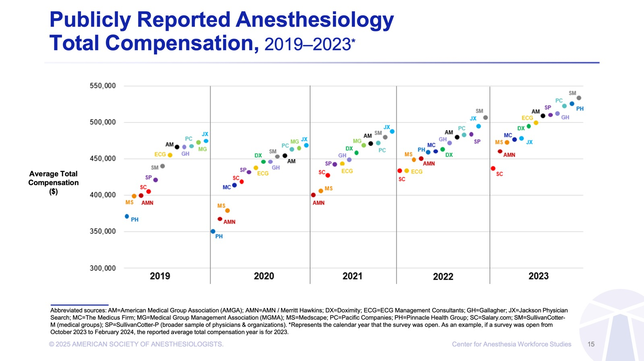


Slide 11
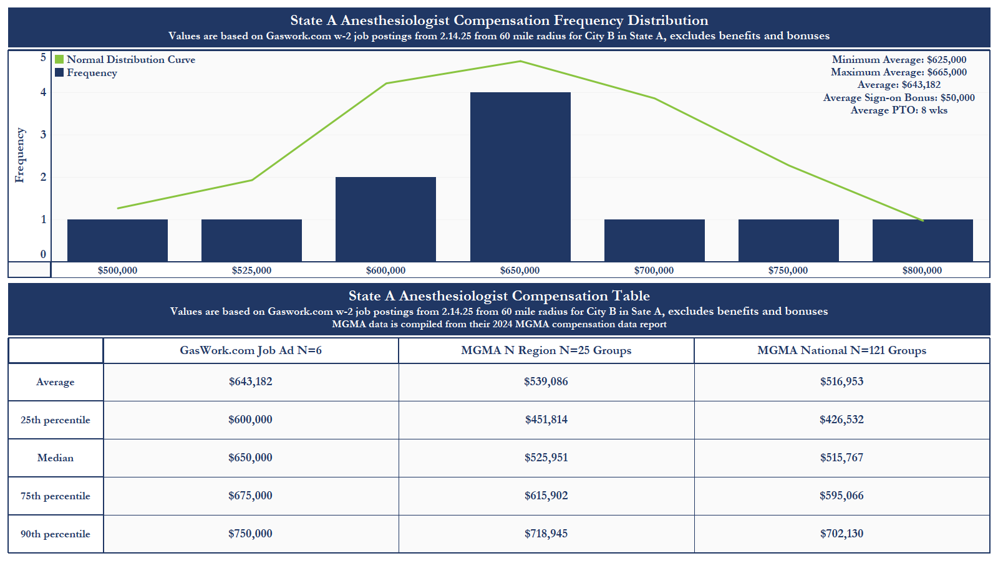
11

Slide 12
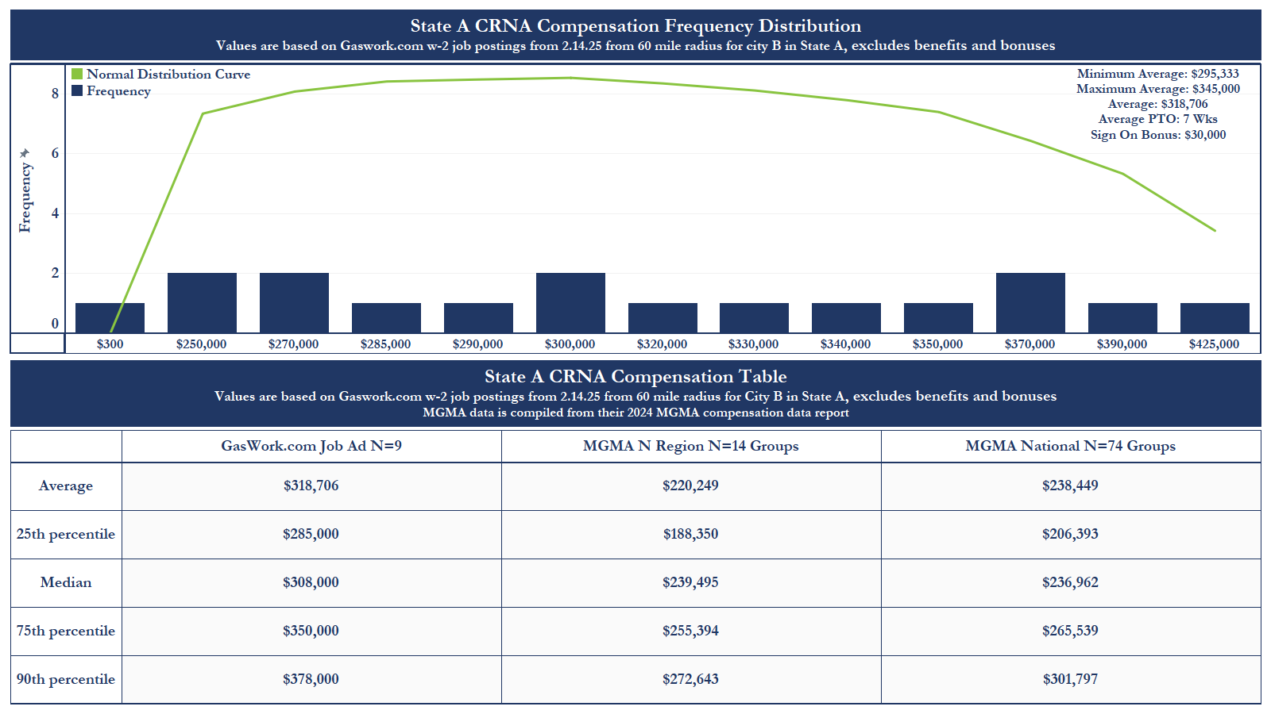
12

Slide 13
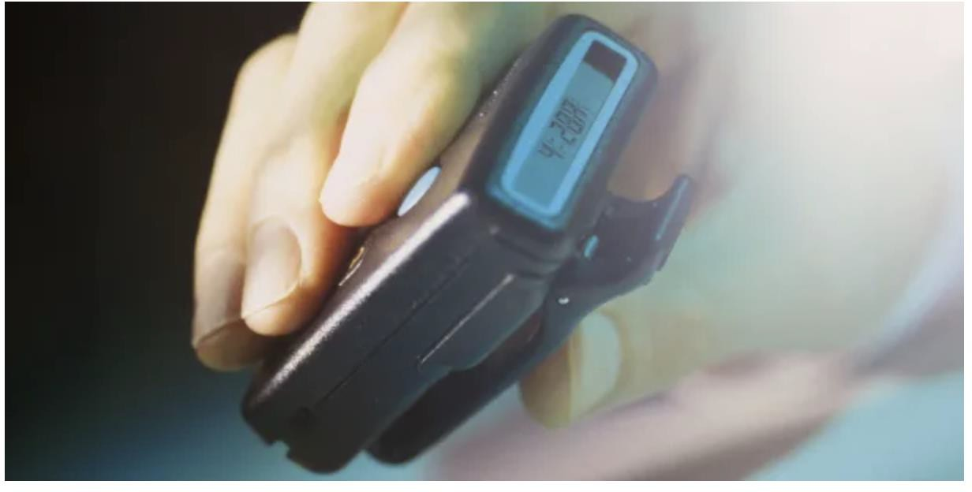
The Value of Physician Availability
“The time frame of availability also matters. This means that my husband, a firefighter, works for 48 hours straight and is paid for all of those, regardless of how many are spent on actual calls”
’Meanwhile, our health insurance industry operates on the opposite framework: higher reimbursement for elective procedures and less for emergent ones, including no compensation at all for access to those services at all hours. Our availability, like our safety and proficiency, are taken for granted by everyone in the conversation.”
“Physicians' acceptance of call as "part of the job" has failed to check the excesses of the health system in its demands for our time. Availability of care is one of the drivers of market competitiveness and yet the pressure on physicians created by that availability remains wholly uncompensated by the biggest winners in the game: hospitals and insurers.
https://opmed.doximity.com/articles/the- value-of-physician-availability.
“Thus, I circle back to the one option that offers a solution to the availability problem: locums work. I would never dream of taking call for free. Nor would the systems expect me to, and yet that was expected in every other job I've ever held..”
Shannon Elizabeth Meron, M.D. March 10, 2025

Slide 14
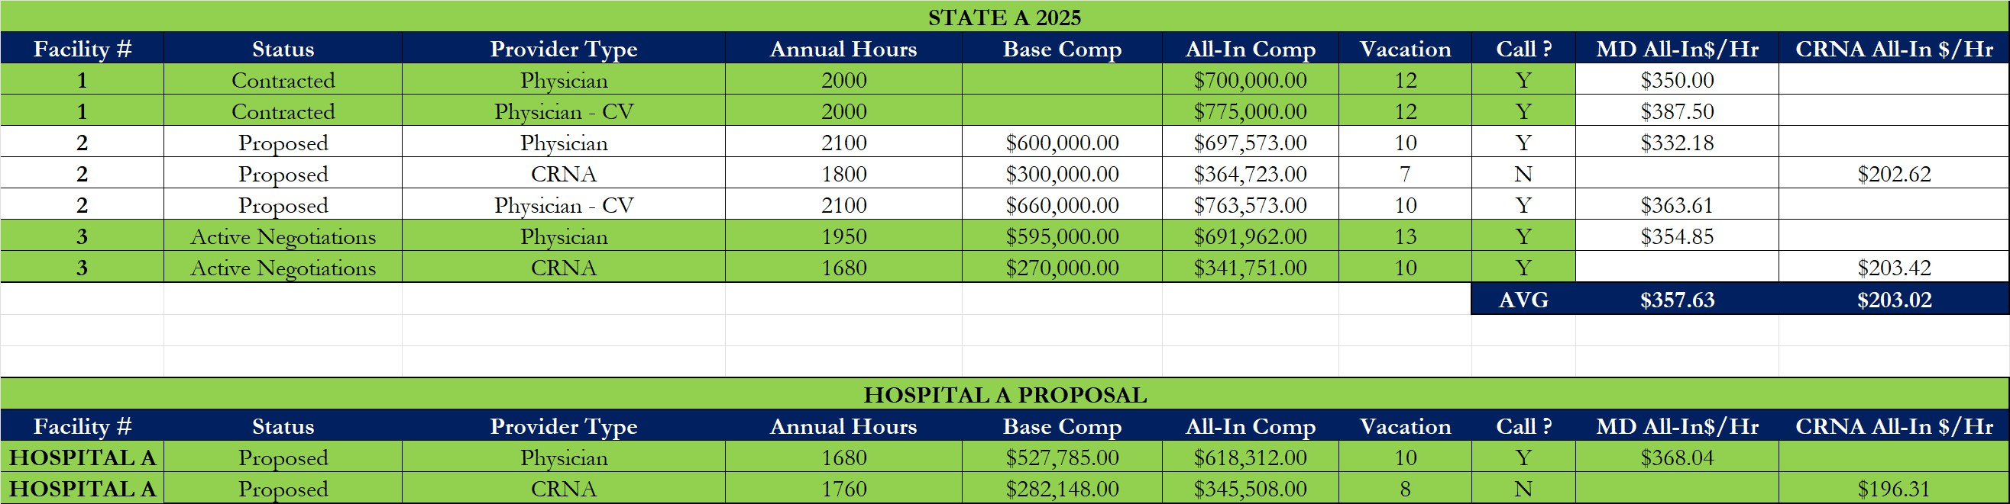

Normalizing Compensation

Slide 15



How many Rooms do we run vs. How many Rooms should we Run??
Hospitals & ASC’s always want
more sites than they need
Most anesthesia groups feel they
are poorly utilized
Ultimately need to balance cost vs. capacity
Data and benchmarking can
significantly impact this discussion
OR utilization data from OR logs or anesthesia billing data should be analyzed
Stop looking thru rose-colored glasses and use real data !!

Slide 16
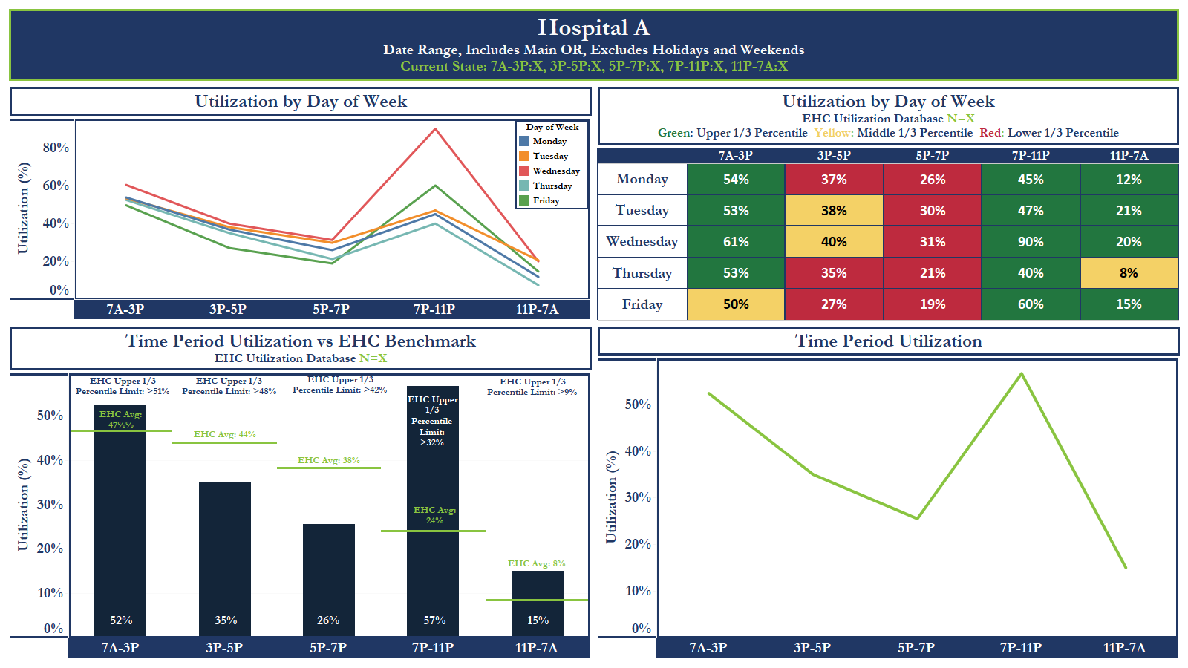
16

Slide 17
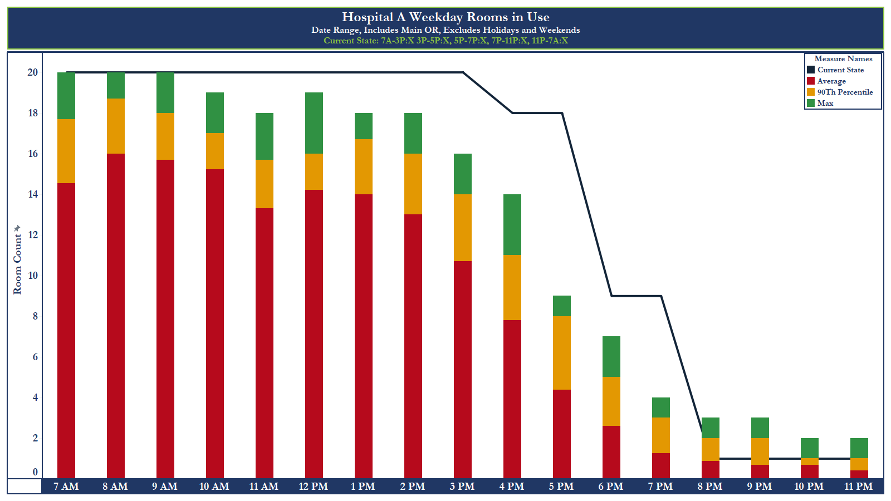

Slide 18
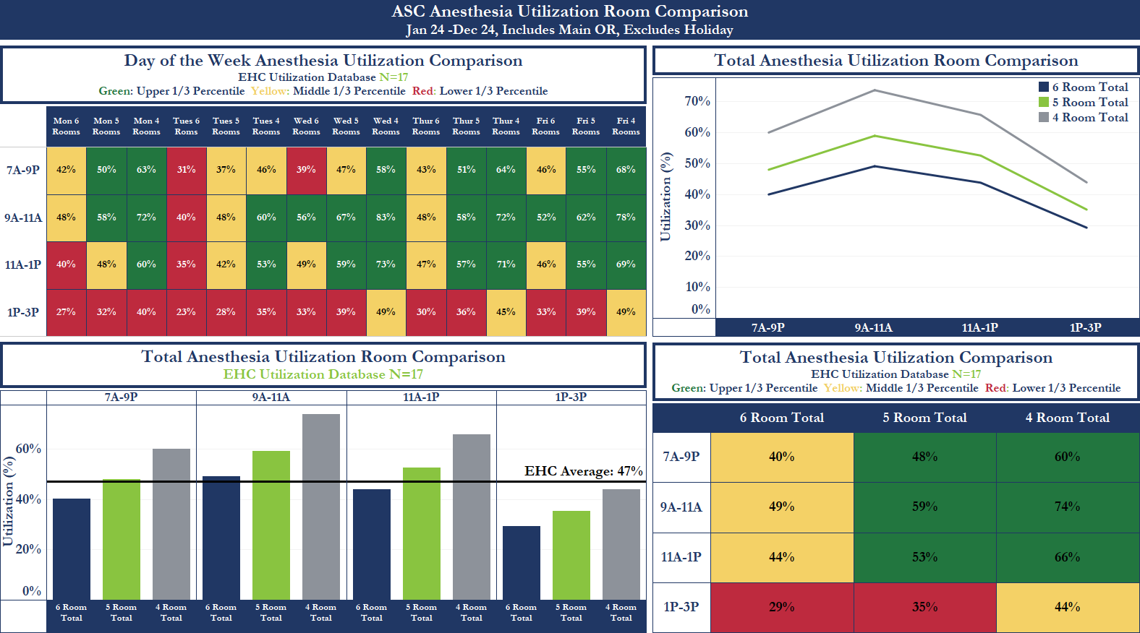

Slide 19
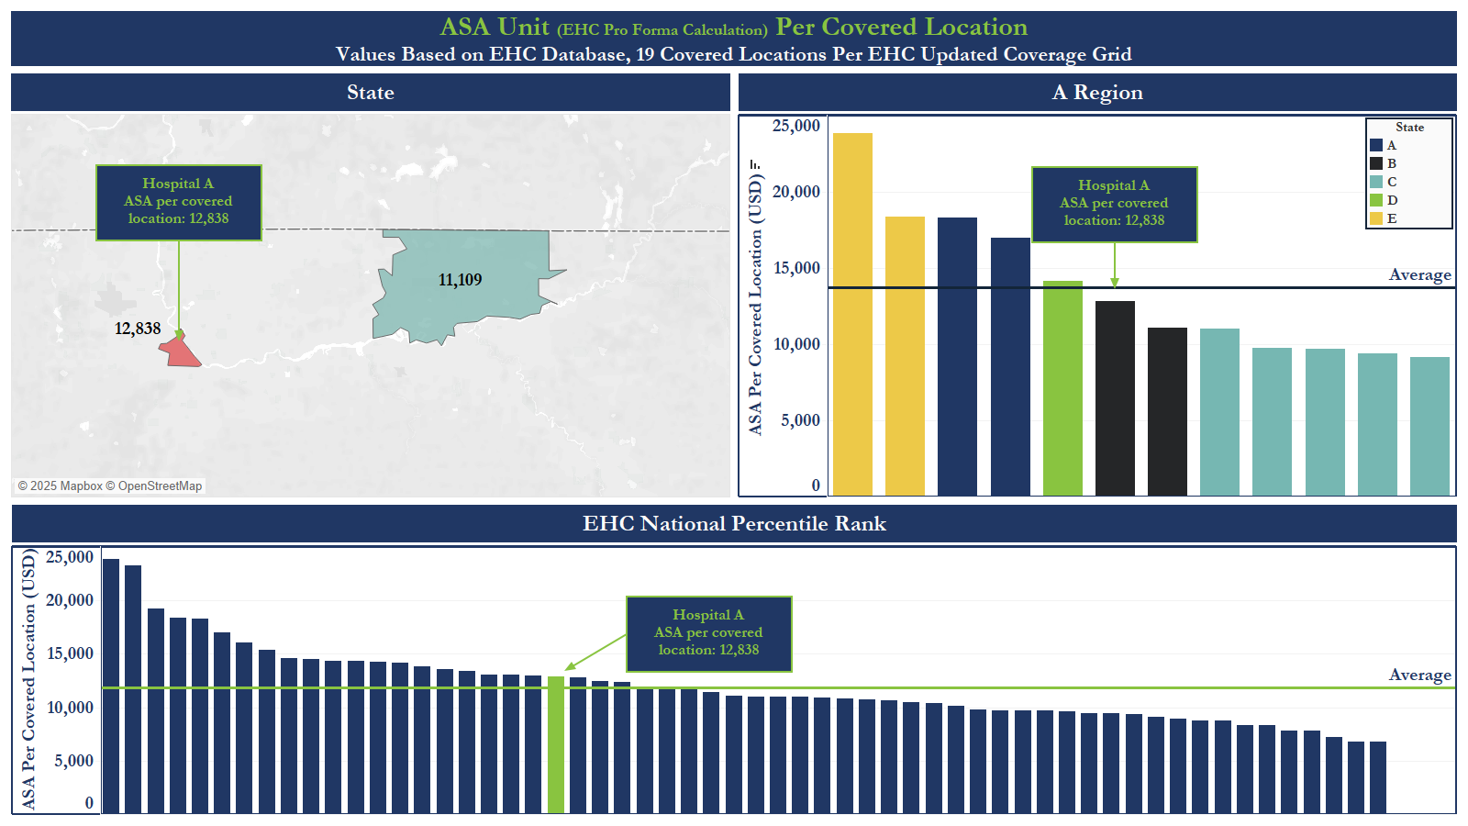
19

Slide 20
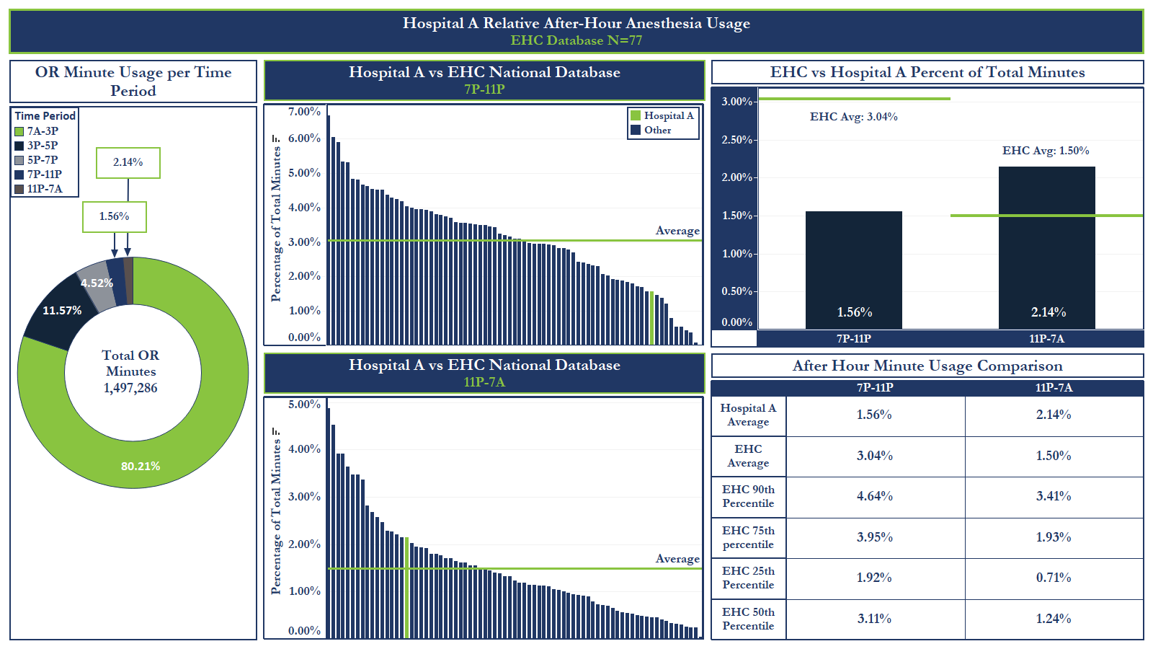

Slide 21

What Does the Staffing Model Look Like?
Hospitals often want a highly leveraged model
The ability to quickly model changes and the associated financial implications facilitates active negotiations
Assumed physician work hours is becoming much more variable
This impacts the number of CRNA’s needed to cover
the hours per MD
Impacts the relative equality we now see between MD only and medically directed models
Visuals support the discussion
3 Models of the same coverage grid in next 3 slides
Very difficult to hit the number on the nose!!

Slide 22
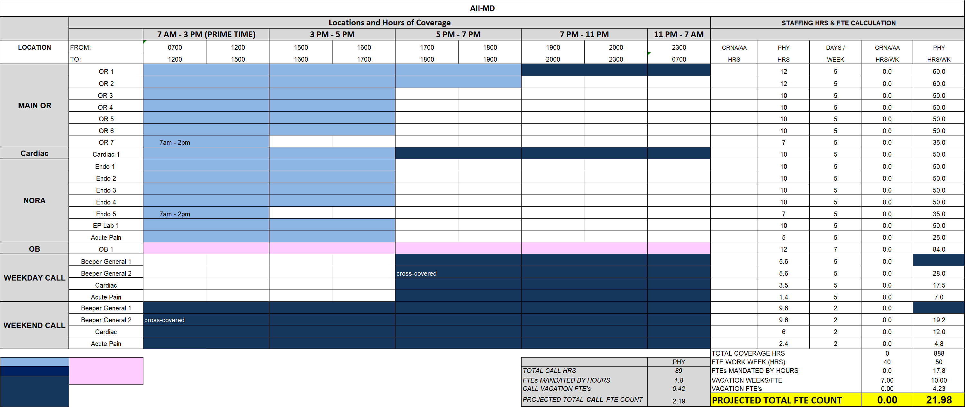
ALL PHYSICIAN VERSION
22

Slide 23
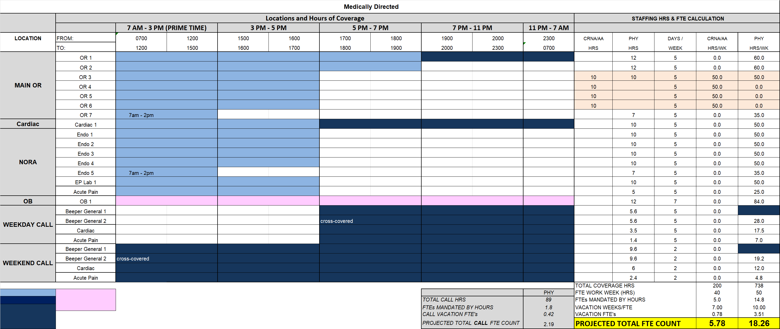
CARE TEAM VERSION
23

Slide 24

INDEPENDENT CRNA VERSION
24

Slide 25
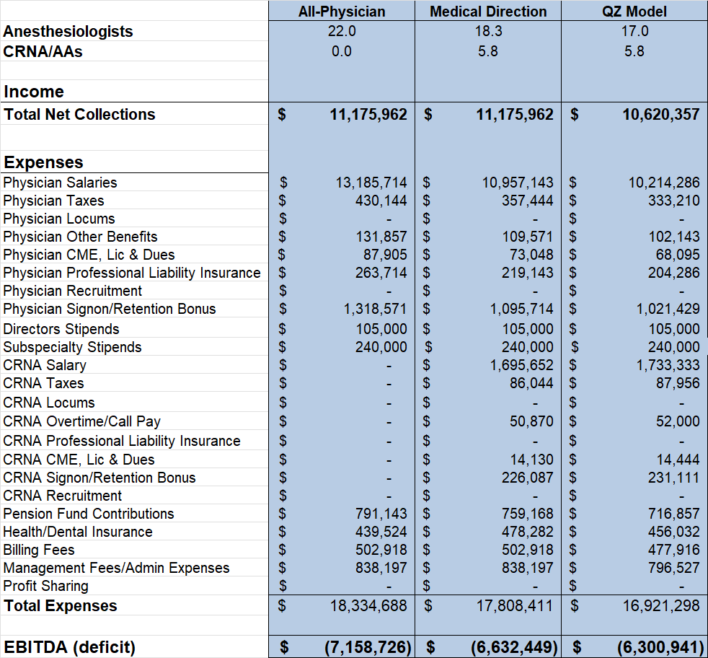
Cost Comparison of various staffing models

Slide 26

Show me the Money!
Hospitals are concerned with paying for poor revenue cycle management
They are also are generally unaware of the nuances of anesthesia reimbursement
Transparency and regular reporting can help assure facility leaders - data can help!!

Slide 27
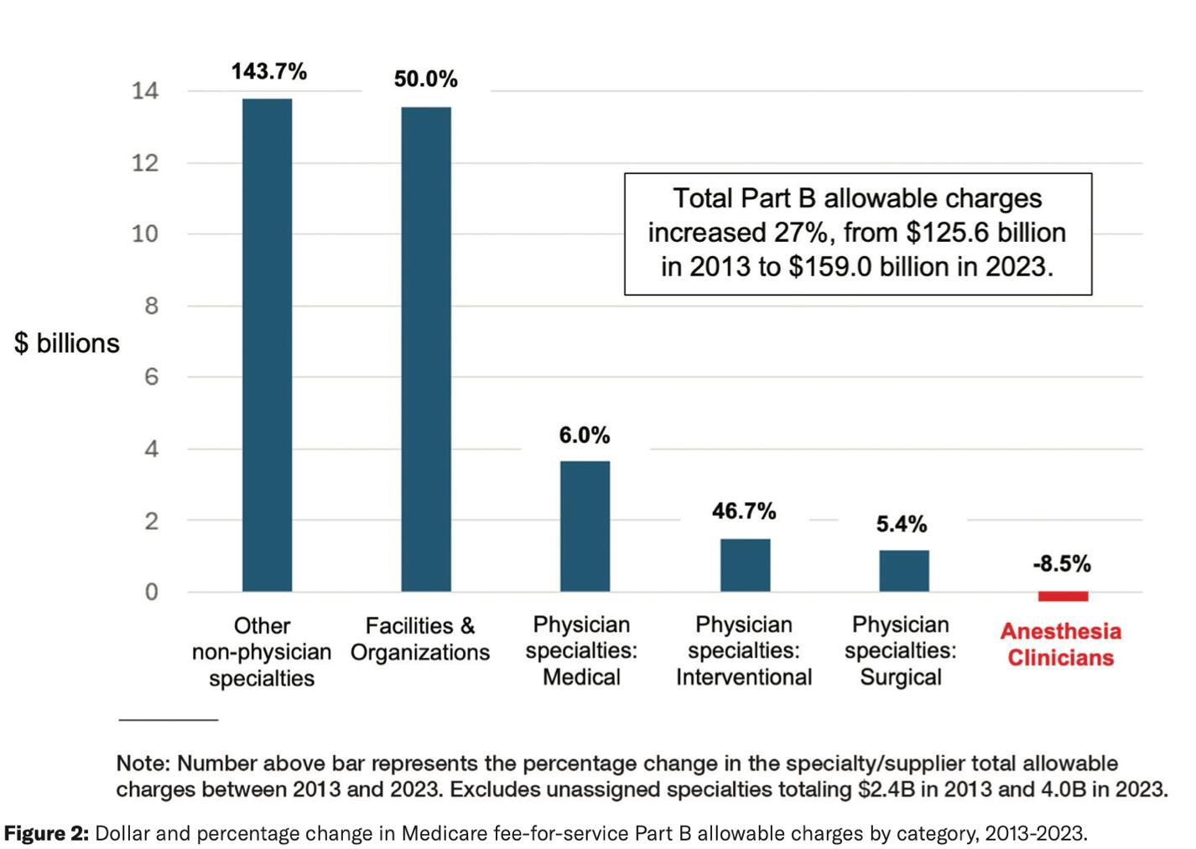
ASA Monitor March 2025
Total Medicare allowable charges for the anesthesiology specialty were 14% less in 2023 than in 2013.
In aggregate, anesthesiologists’ and other
physicians’ share of Medicare FFS Part B allowable charges has declined by 9 percentage points in the decade.
Recent payment policy changes and pressures from commercial insurers may
compromise patient safety and the
ability of anesthesiologists and other physicians to compensate for this decade of Medicare-driven decompensation.

Slide 28
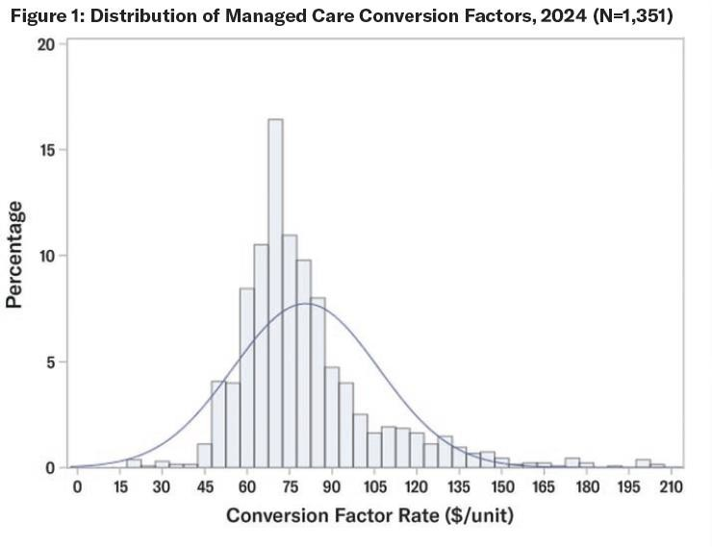
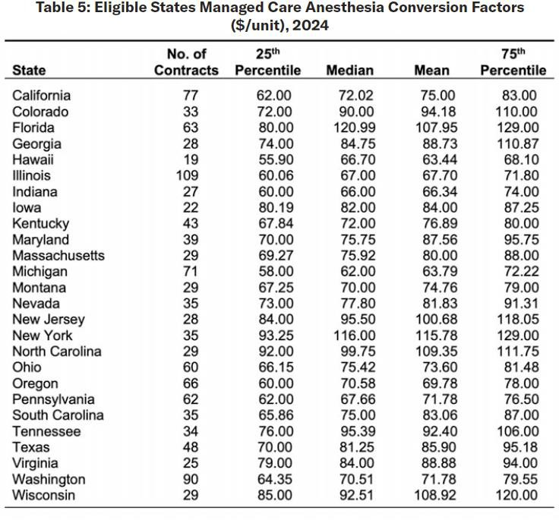

2024 ASA Conversion Factors
Current Payor Rates 2024/2025
Payor | Rate
1 | $103/ASA Unit
2 | $97/ASA Unit
3 | $99/ASA Unit
4 | $93/ASA Unit
National Average Anesthesia Conversion Factor – 80.70

Slide 29
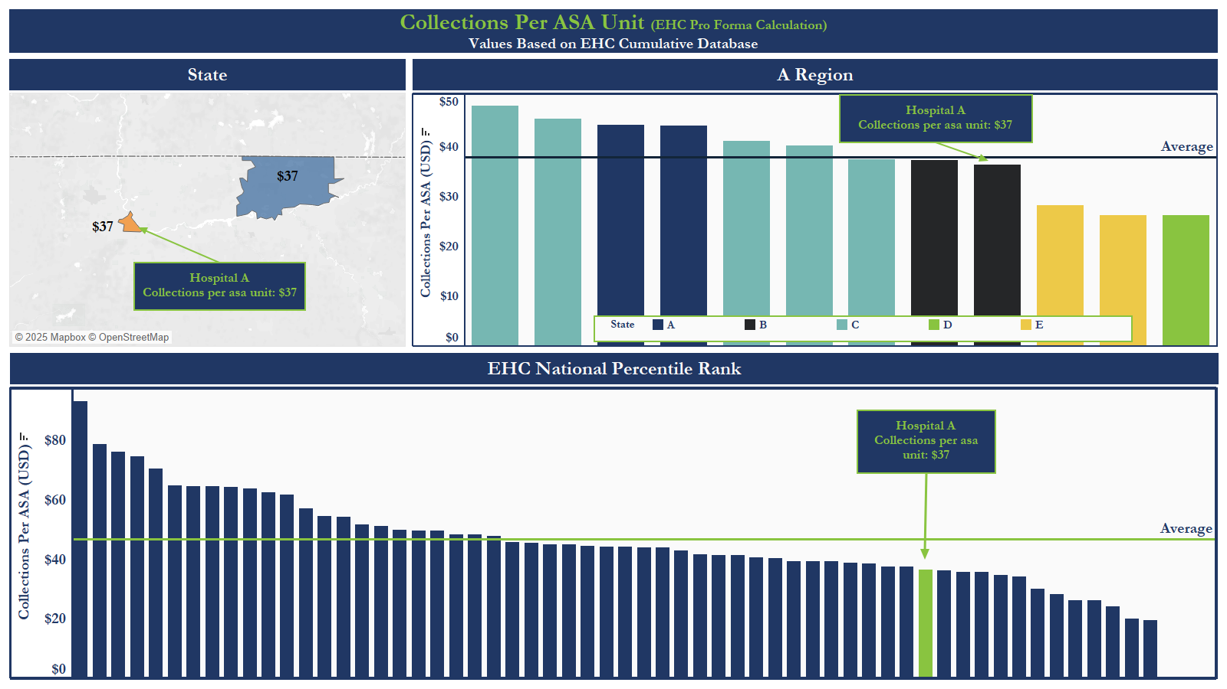

Slide 30
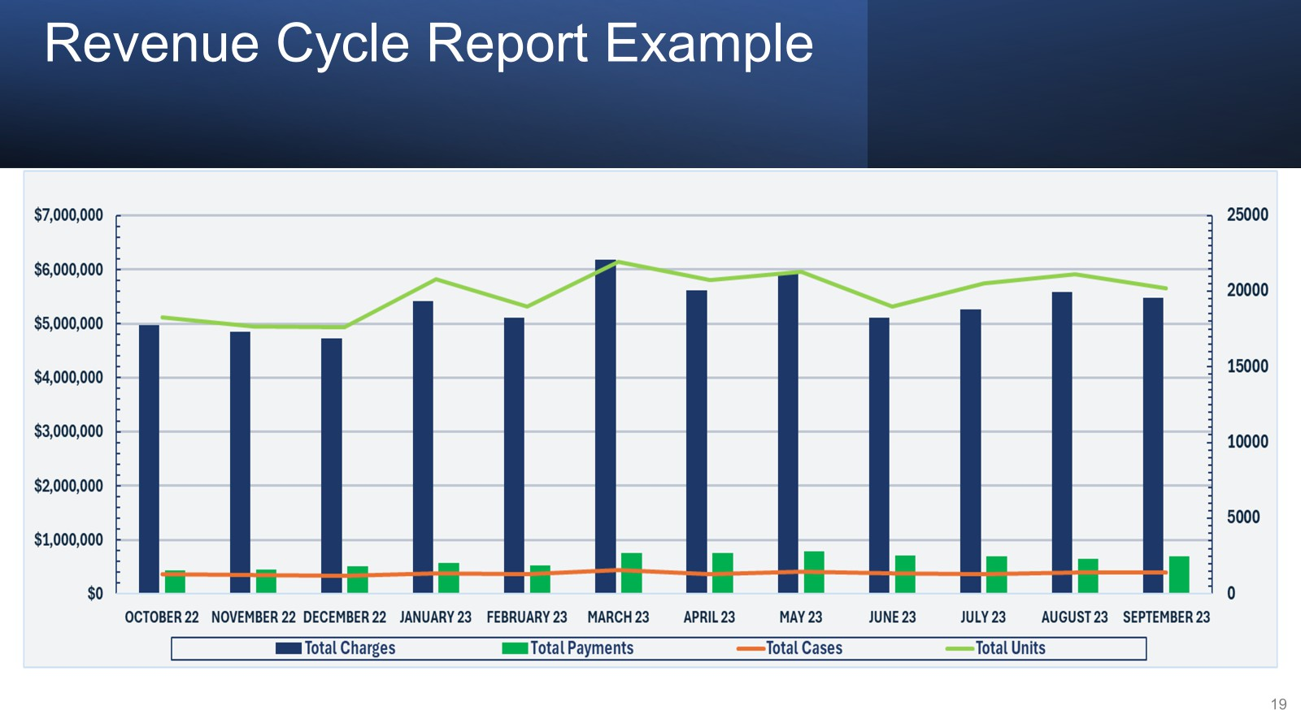

Slide 31
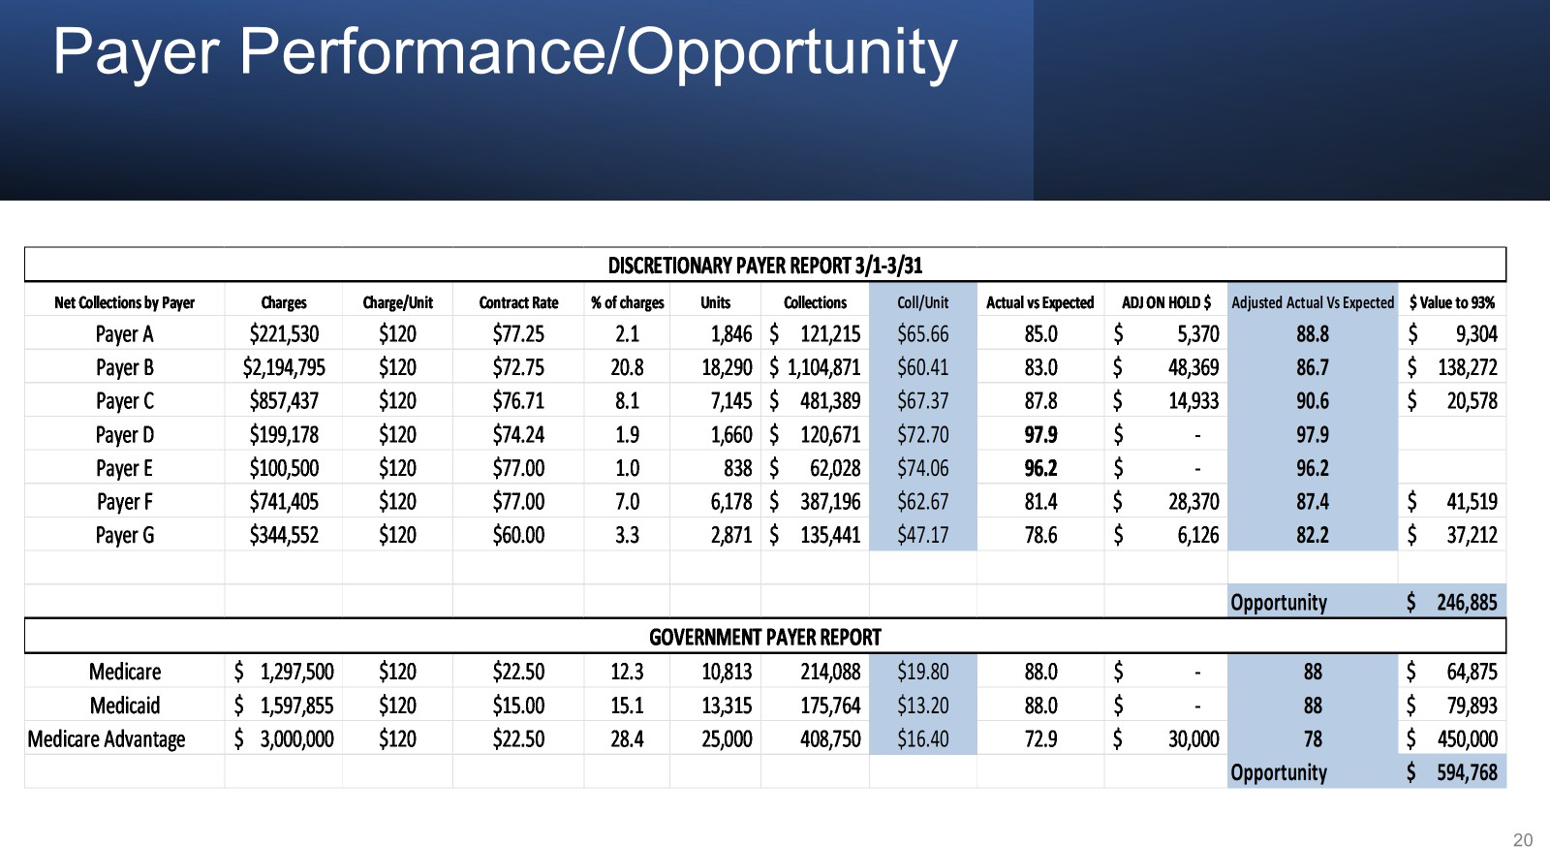

Slide 32
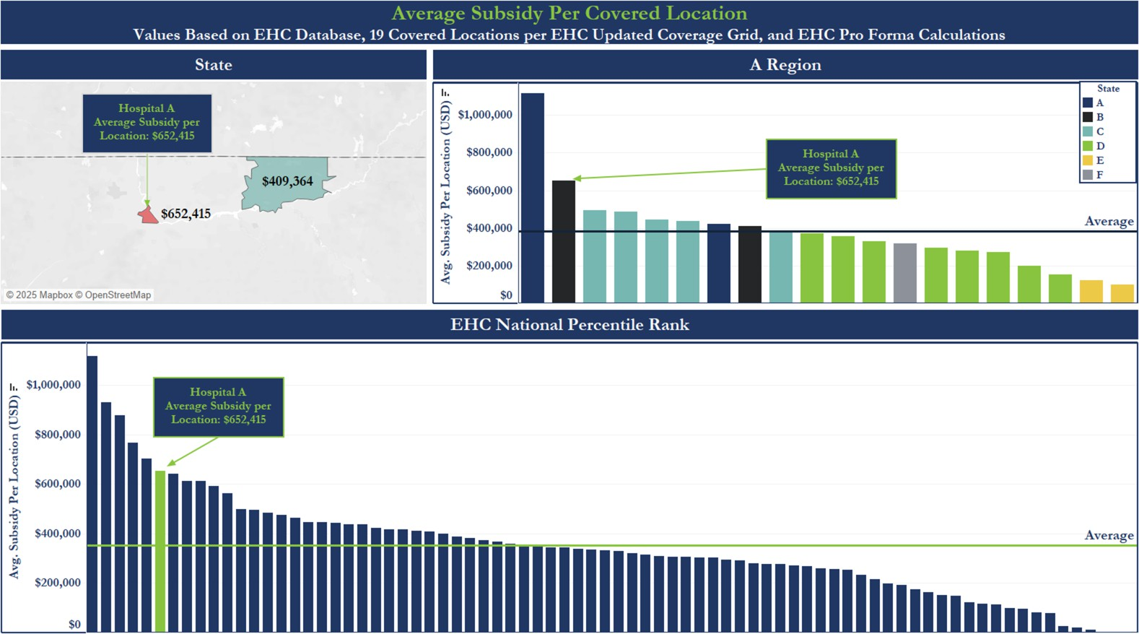

Slide 33

Satisfaction
Stakeholder satisfaction is important to showing value
Stakeholders include surgeons/proceduralists, administrative leaders and service line leaders
Proven satisfaction supports maintenance of the anesthesia contract
Standardized survey points and the ability to benchmark against other groups is important - data can help!!

Slide 34
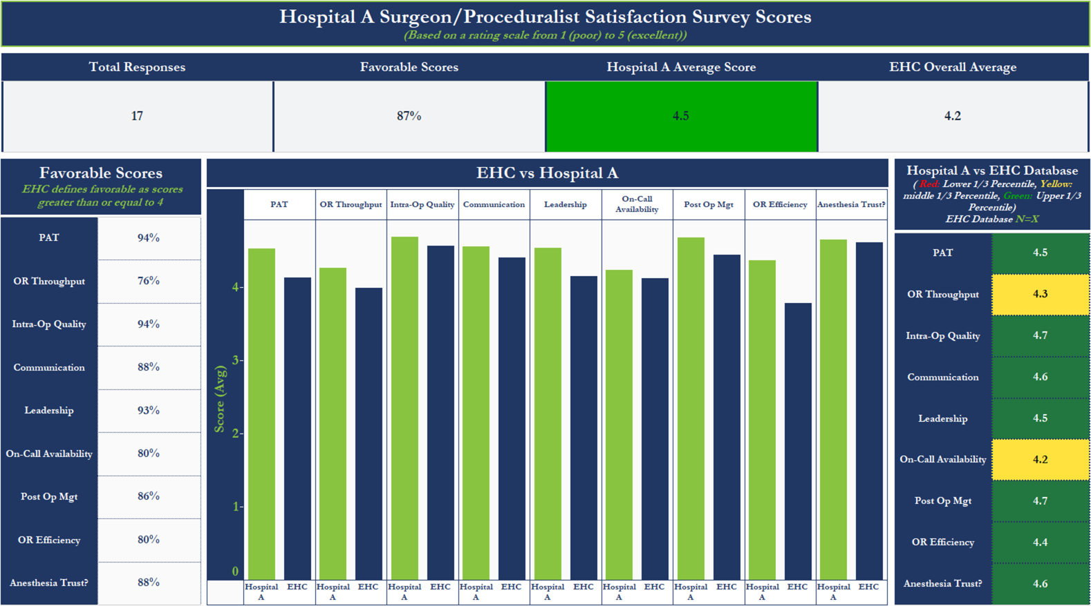

Slide 35
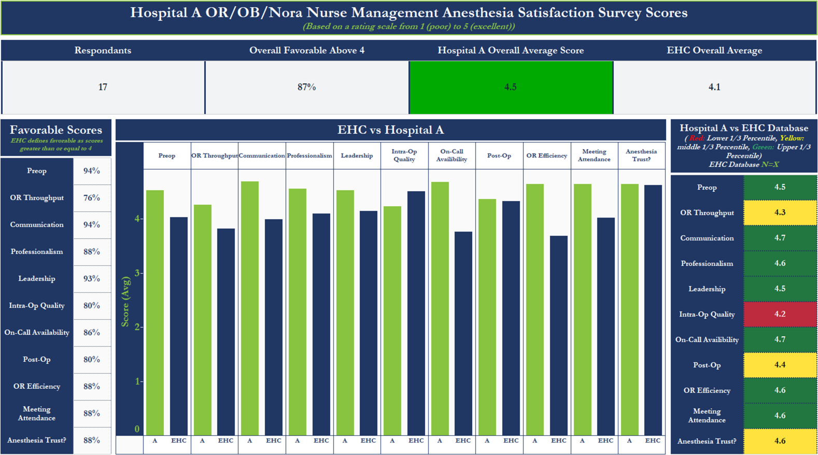

Slide 36
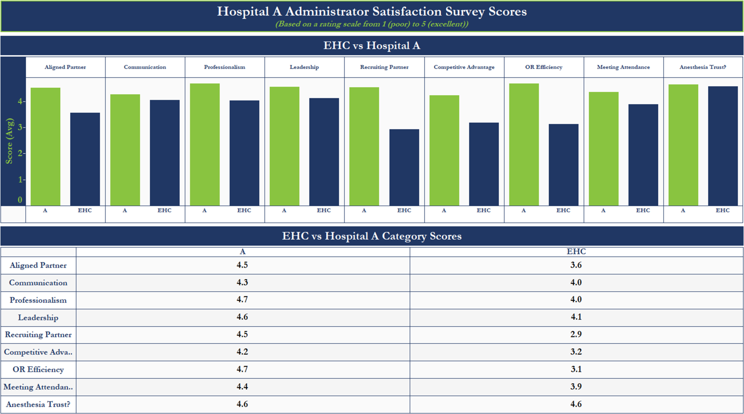

Slide 37

Any Questions?
Howard Greenfield, MD hgreenfield@enhancehc.com 954-242-1296
Robert Stiefel, MD rstiefel@enhancehc.com 863-610-2085

